Slide 1
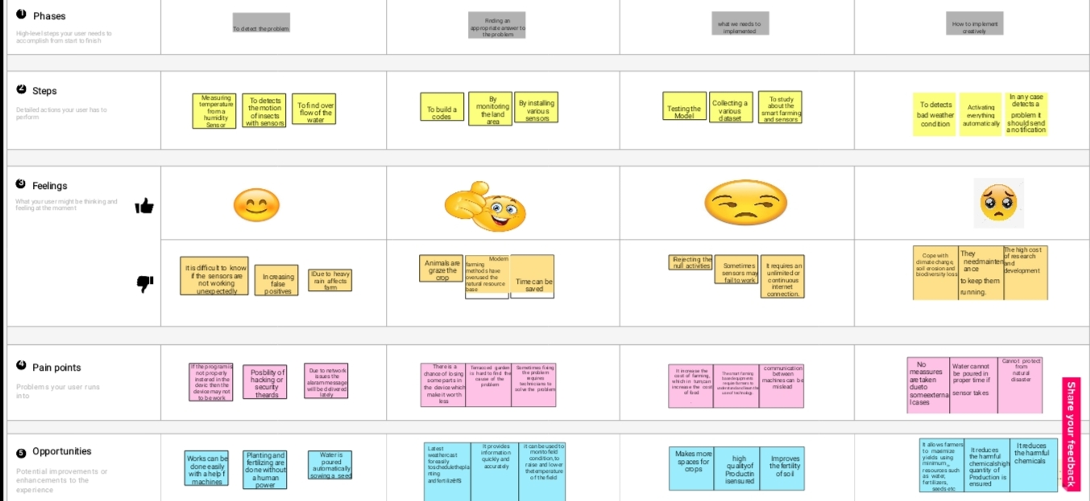
Project Design Phase-II Customer Journey Map
Date | 08 October 2022
Team ID | PNT2022TMID49497
Team Leader | Mr. Varun Pandiyan (923819104056)
Team Member | Mr. Gunaseelan (923819104302), Mr. Surya Prakash (923819104047), Mr. Rajadurai (923819104036).
Project Name | Smart Farmer – IoT Enabled Smart Farming Application
Maximum Marks

